Slide 1
Factorial Design
Mark Keck, Don Treptow, Alicia Lansford

Slide 2
Overview
Factorial design was created by John Bennet Lawes and Joseph Henry Gilbert in the 19th century
Experimental design which has two or more factors
Experimental units take on all possible combinations of these levels across all such factors
The idea was to take other factors into biological research like weather, or other influences that cannot be controlled and compare them between the treatments

Slide 3
Overview
Allows researchers to study the effect of each factor on the response variable
For most, experiments, have 2 levels
4 treatment combinations
Infinite number of factors – 2^{k} , where k = number of factors
Allows researchers to judge if there is a link between factors

Slide 4
When to implement
When research has too many variables that can effect the treatment and it would be too costly and timely to test individually
Thus, use when you have many different factors across one experiment

Slide 5

Statistical Model
$y= μ+ α+ β+\left(α∙β\right)+ ∈$
$μ$ = overall mean
$α$ = column effect (Factor A)
$β$ = row effect (Factor B)
$α∙β$ = interaction effect
$∈$ = error

Slide 6
Example 2 x 2 Experimental Design
Look at the effect of beta carotene and asprin on heart attacks
Main effects:
What effect does asprin have on heart attacks independent of beta carotene?
What effect does beta carotene have on heart attacks independent of asprin?
Interactions:
How does beta carotene interact with asprin, as far as preventing heart attacks?

Slide 7
Example 2 x 2 Experimental design
Beta-carotene
Yes
No
Yes
Beta Carotene & Asprin
Placebo & Asprin
Asprin
No
Placebo & Beta-carotene
Placebo & Placebo

Slide 8
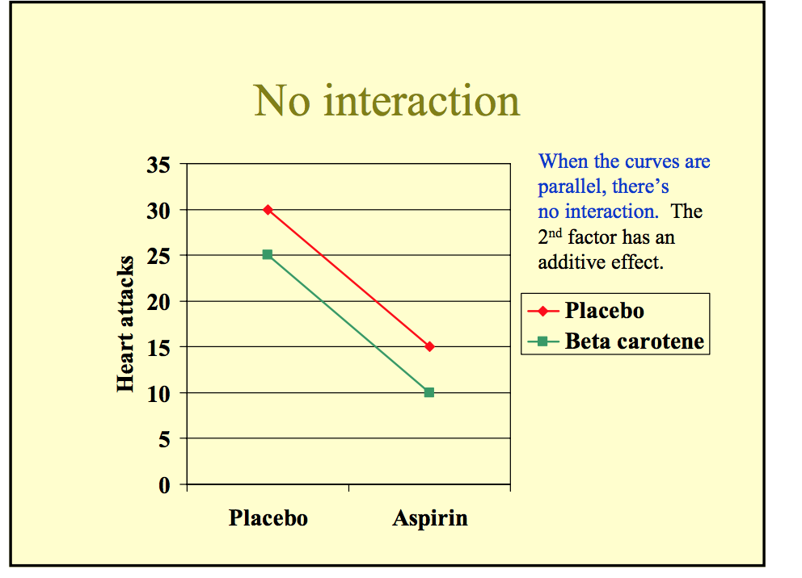
Example Analysis

Slide 9
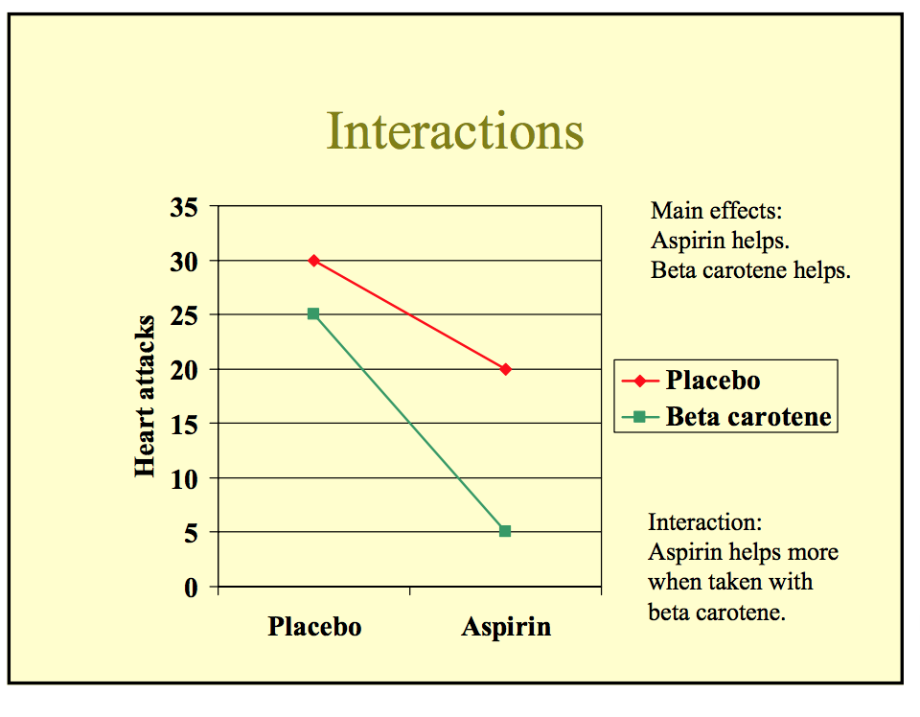
Example Analysis

Slide 10
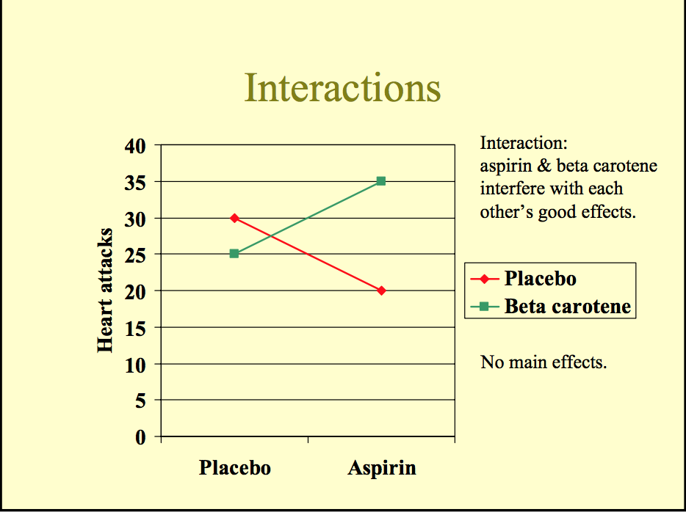
Example Analysis

Slide 11
Error
Factorial design reduces experimental error levels
Experimental error can be estimated in 2 ways
Replication
Sparsity-of-effects principal
If there are many factors and replication would be too costly
Sparsity-of-effects principal
States that a a system is usually dominated by main effects and low order interactions
States that main effects and two-factor effects would be most significant
Only a few effects in the system are actually significant

Slide 12
Analysis
Can be analyzed using and ANOVA or regression table
Visually, graphs are easy to look at
Differing slopes are indicative of interactions

Slide 13

Example 2
Main Effects:
H0: $μ$_{A1} = $μ$_{A2}
H0: $μ$_{B1} = $μ$_{B2} = $μ$_{B3}
HA: means not all equal
Interaction
H0: There is no interaction effect in the population – regardless of level
$μ$_{A1B1} - $μ$_{A1B2} = $μ$_{A1B2} - $μ$_{A2B2} = $μ$_{A1B3} - $μ$_{A2B3}
HA: not all differences are equal

Slide 14
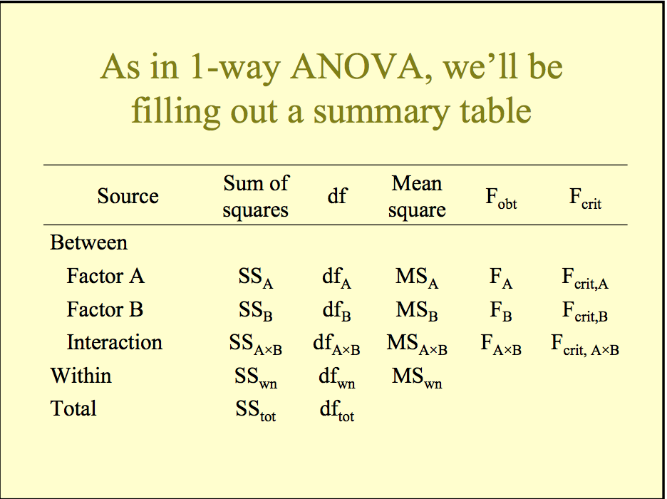
ANOVA
df_{A} = # of levels of factors for A -1
df_{B} = # of levels of factors for B -1

Slide 15
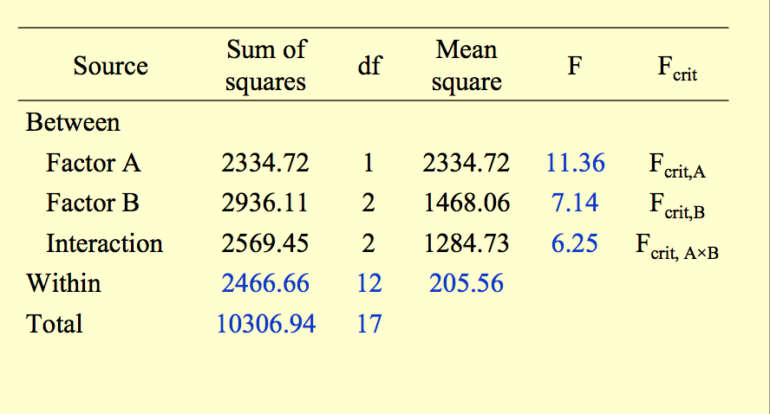
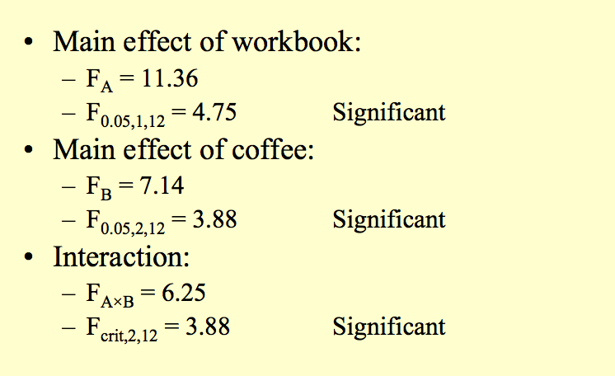
ANOVA

Slide 16
Conclusion
Factor A did have a significant effect on the dependent variable
Factor B did have a significant effect on the dependent variable
There was an interaction between factors A & B

Slide 17
Sources
Examples
https://ocw.mit.edu/courses/brain-and-cognitive-sciences/9-07-statistical-methods-in-brain-and-cognitive-science-spring-2004/lecture-notes/20_anova3.pdf
Overview
https://en.wikipedia.org/wiki/Factorial_experiment
https://explorable.com/factorial-design
http://study.com/academy/lesson/what-is-factorial-design-definition-example.html

